Slide 1
SCSIT
V Semester
Databases 2
Lecturer: Zoran Gichevski
Domain Consultat/Team Lead at Avenga (previously Qinshift/Seavus)
Operations Center | Managed Services

Slide 2
Lecturer
Zoran Gichevski
Responsible for 24/7 IT Operations & Support and IT Helpdesk Teams at Operations Center | Managed Services Division.
Contact:
  Email: zoran.gichevski@uacs.edu.mk
  LinkedIn: https://mk.linkedin.com/in/zoran-gichevski

Slide 3
Databases 2
Lecturer/Mentor: Venera Gudachi, PhD
Assistant/Collaborator: Zoran Gichevski
Schedule hours:
  Group 1: Monday 16:30-18:30
Room: L2 /2nd floor
Consultation hours: On demand

Slide 4
Weekly delivery plan
Lecture 1 – 6
Mid Term Exam
Lecture 7 – 12
Reading week
Final Exam
MakeUp Exam

Slide 5
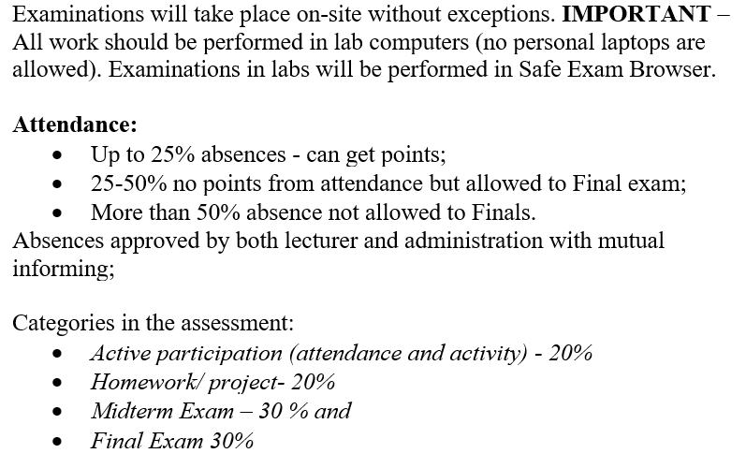
Evaluation structure and assessments during teaching semester

Slide 6
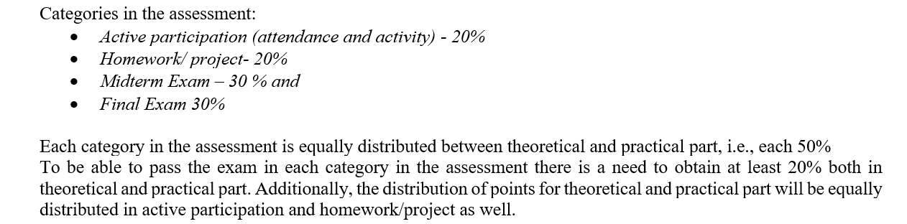
Evaluation structure and assessments during teaching semester

Slide 7
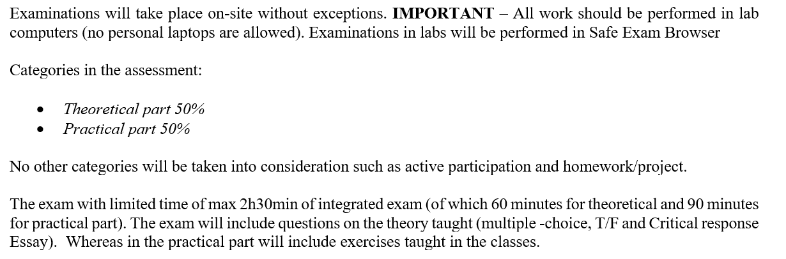
Evaluation structure and assessments for MakeUp examinations

Slide 8
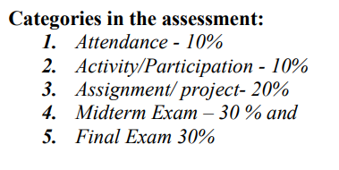
Evaluation structure and assessments during teaching semester
Attendance: 10% from Practical part
  Attendance: 5%
  Activity/Participation: 5%
Homework: 10% from Practical part
Mid Term Exam: 15% from Practical part
Final exam : 15% from Practical part

Slide 9
Used programs during semester
Diagram.net (draw.io)
Microsoft SQL Server
  DB Engine: MS SQL Server 2019 Express Edition https://www.microsoft.com/en-us/download/details.aspx?id=101064
  SQL Management Studio (SSMS) 18.12 https://learn.microsoft.com/en-us/sql/ssms/download-sql-server-management-studio-ssms?view=sql-server-ver16
  MongoDB Compass
  https://downloads.mongodb.com/compass/mongodb-compass-1.50.0-win32-x64.exe

Slide 10
Classes learning flow
Learning materials will be on Moodle
  Presentation – available after the classes
  Exercises – available after the clases
  Homework – after the classes
    Deadline 7 days after publishing
  Additional info or materials
    Upon request on Moodle

Slide 11
Questions ?

